Slide 1


GLOBALCERT DATA SCIENCE INTERNSHIP TASK-2 Week-2 Analysis AUTOMATED SYSTEM FOR APPLICANT SELECTION
Presented by
TEAM-4

Slide 2


PROBLEM DEFINITION
GlobalCert is looking for full-time employees for a variety of roles with different pay levels. They want to extend their firm into different dynamics as a fledgling start-up, which demands recruiting extremely competent and acceptable employees to run their firm. Furthermore, they need your help as they lack a sufficient automated system to optimize their hiring process.

Slide 3
ABOUT THE DATASET
There is quite a number of columns we have considered in our dataset.
By using the method of open source data we have constructed our own database with the following columns-
Name
Contact Number
Gender
Age
10th Board and percentage
12th Board and percentage
12th field
History of Backlogs
English test percentage
Department applying to
If MBA, percentage
Work experience
Salary expectations per month
Bachelors degree and percentage

Slide 4
APPROACH
COMPANY
AUTOMATED SYSTEM
Filling in the google form or applying on the website
Details get stored on the database
Processing the data using the automated system build
The potential applicants move on to the later interview rounds
Data gathering using the open source data method
Processing the data department wise using Quartile Method
Displaying the top 10 potential applicants
Splitting the data department-wise

Slide 5
ANALYSIS
Analysis is performed using the following parameters-
10th,12th and degree percentage
MBA grade
History of backlogs
Work experience
Departments considered-
Customer Service
Marketing and HR
Teaching
Marketing and Finance
Technical

Slide 6
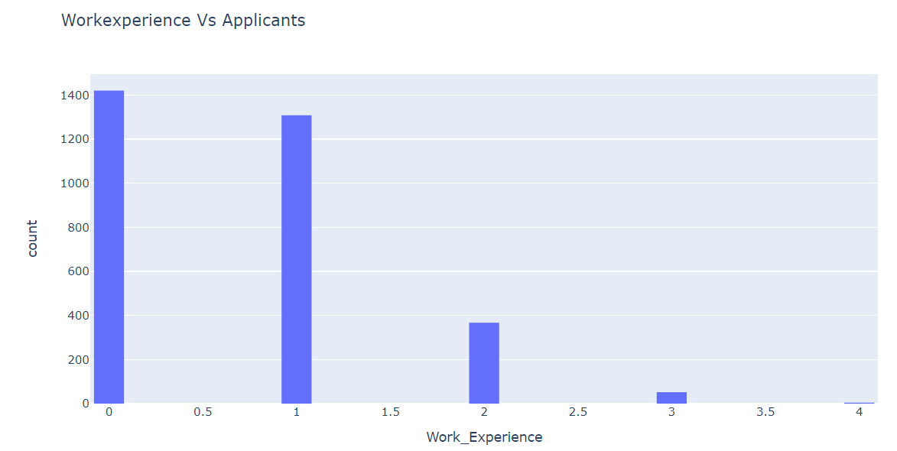
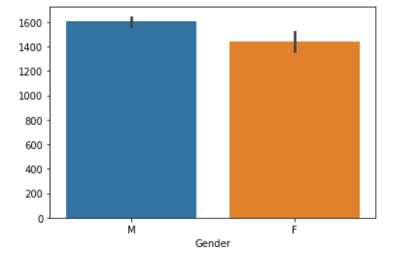
GENERAL ANALYSIS
Maximum no of applicants have 0 and 1 year of work-experience
Gender ratio of the applicants
Around 1600 male and 1400 female applicants
( depends on the situation to maintain the gender ratio)

Slide 7
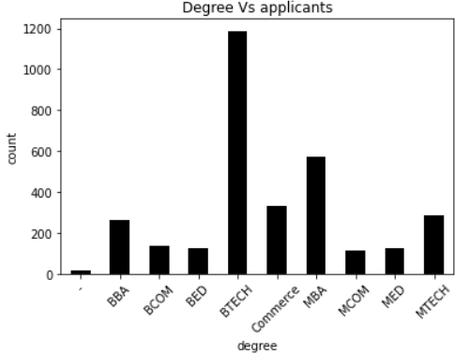
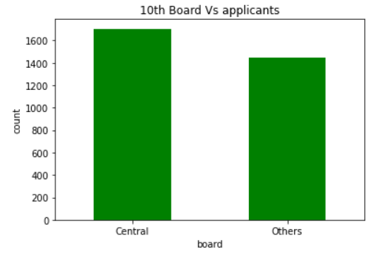
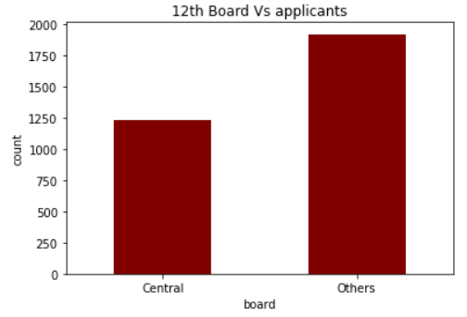
Maximum applicants have pursued Btech while the least with MCOM and MED
Maximum applicants have studied their SSC in Central Board
Maximum people have studied their HSC from other boards

Slide 8
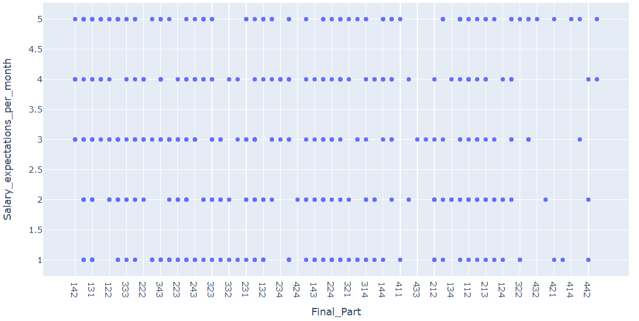
1. MARKETING AND HR
Considering the factors ( 10th grade, 12th grade, degree grade and History of backlogs) we have the final graph as given below-
0-20k=1
20k-40k=2
40k-60k=3
60k-1L=4
1L-1.2L=5
Displaying top potential applicants with Final_Part: 343,344,443,444 (quartile method- a part of RFM method)

Slide 9
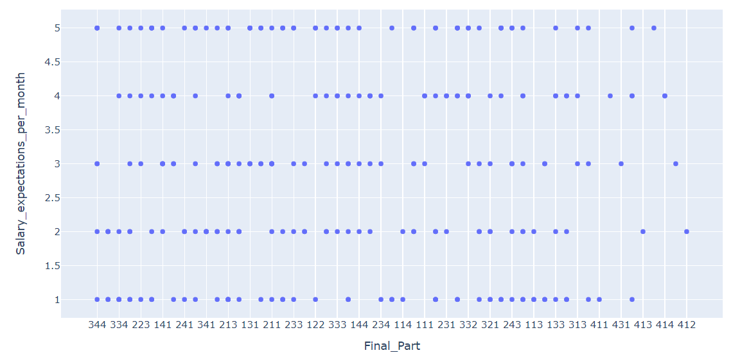
2. MARKETING AND FINANCE
Considering the factors ( 10th grade, 12th grade, degree grade, and History of backlogs) we have the final graph as given below-
Displaying top potential applicants with Final_Part: 344,444,343,443 (quartile method)

Slide 10
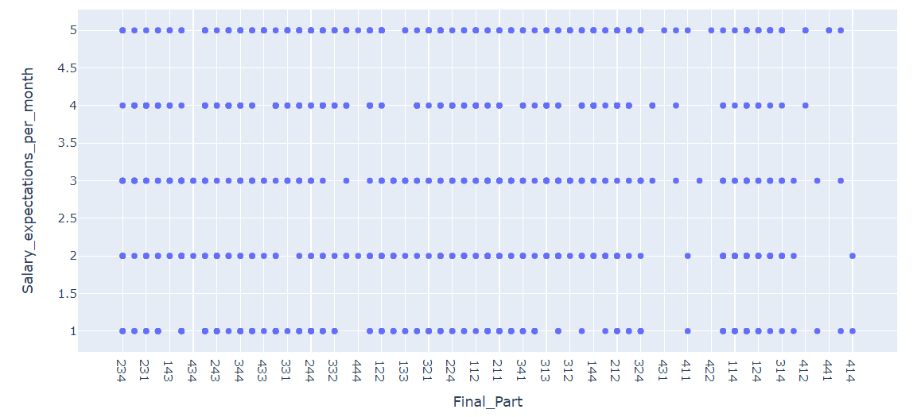
3. TEACHING
Considering the factors ( 10th grade, 12th grade, degree grade and History of backlogs we have the final graph as given below-
Displaying top potential applicants with Final_Part: 344, 444 (quartile method)

Slide 11
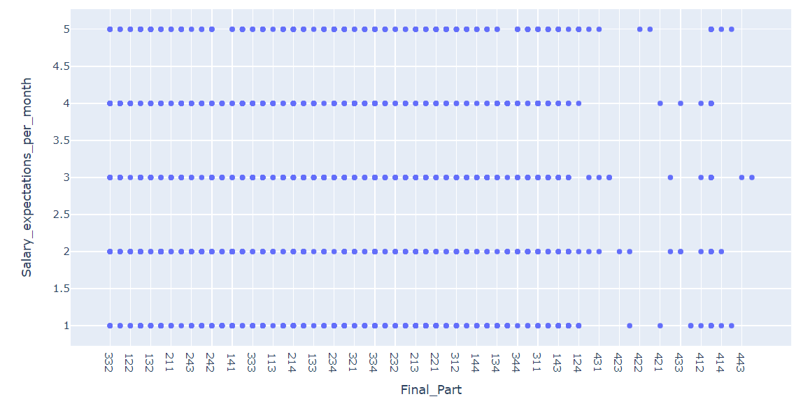
4. TECHNICAL
Considering the factors ( 10th grade, 12th grade, degree grade and History of backlogs) we have the final graph as given below-
Displaying top potential applicants with Final_Part: 343, 344, 443, 444 (quartile method)

Slide 12
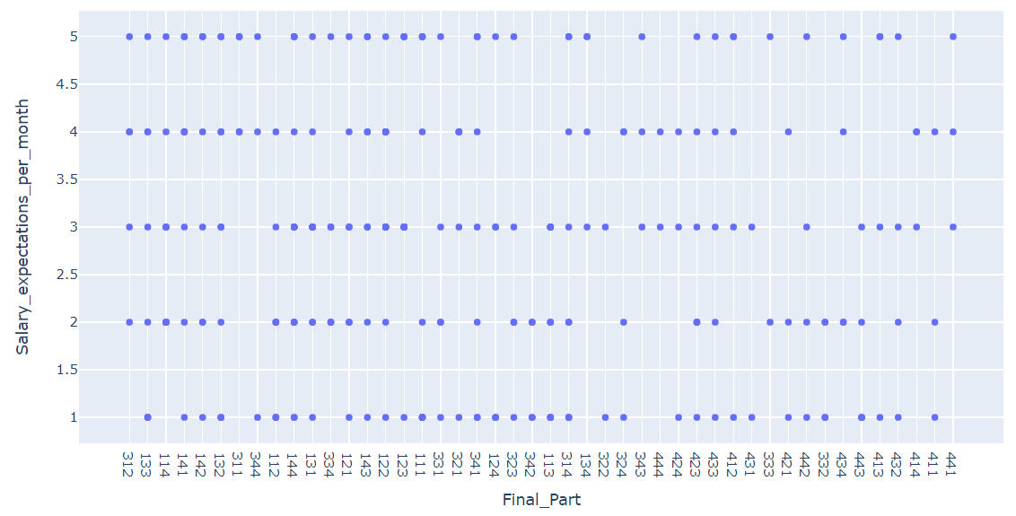
5. CUSTOMER SERVICE
Considering the factors ( 10th grade, 12th grade, degree grade and History of backlogs) we have the final graph as given below-
Displaying top potential applicants with Final_Part: 132, 133, 134, 142, 143, 144, 232, 233, 234, 242, 243, 244, 332, 333, 334, 342, 343, 344 (quartile method)

Slide 13

CONCLUSION
GloberCert received a load of applications in various departments
The automated system is successfully build in a way that, depending on the major factors(10th, 12th, and degree grades, MBA grades if required , history of backlogs and Work-experience the system automatically displays a list of top applicants who should be selected.
10 applicants from each department with the potential to join the department are found. They can be called for the round 2 of the interview for more screening and deciding upon the job profiles.

Slide 14
THANKYOU
- TEAM-4

